Slide 1
API SECURITY RISK ANALYSIS REPORT
Future Interns — Cyber Security Internship
Prepared By:
Sidhanth Achar
Tools Used:
Postman
Browser DevTools
Public Test APIs

Slide 2
INTRODUCTION
Modern applications rely heavily on APIs for communication between applications, mobile platforms, SaaS systems, and cloud services.
Insecure APIs may expose sensitive information, increase attack surfaces, and allow unauthorized access to systems and data.
This project focuses on identifying API security risks using ethical and non-intrusive analysis techniques.
OBJECTIVE
• Analyze public API endpoints
• Identify common API security risks
• Review authentication practices
• Assess data exposure risks
• Suggest remediation strategies
• Improve API security awareness

Slide 3
TOOLS USED
• Postman
• Browser DevTools
• JSONPlaceholder Test API
• Canva / Documentation Tools
Purpose:
To inspect API endpoints and analyze security risks ethically and safely.

Slide 4
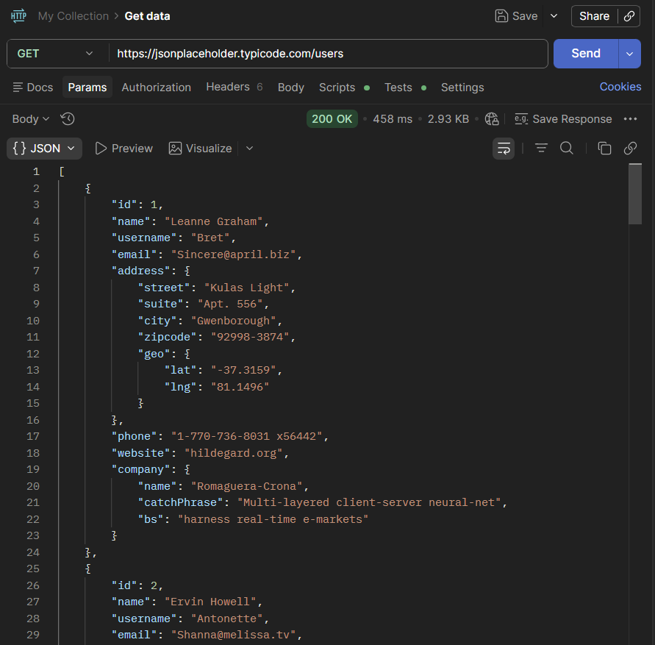
TESTED API ENDPOINTS
/users
/posts
/comments
Observations:
• Public accessibility
• JSON response exposure
• No visible authentication requirements

Slide 5
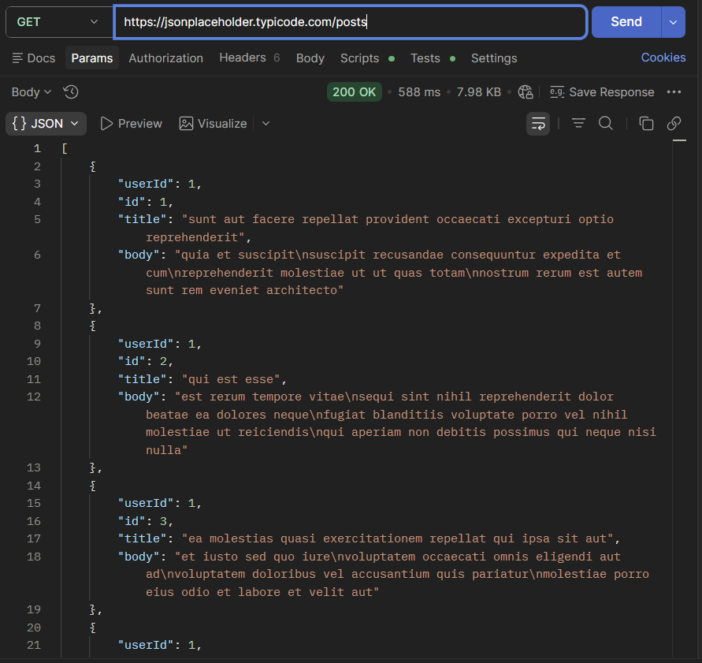
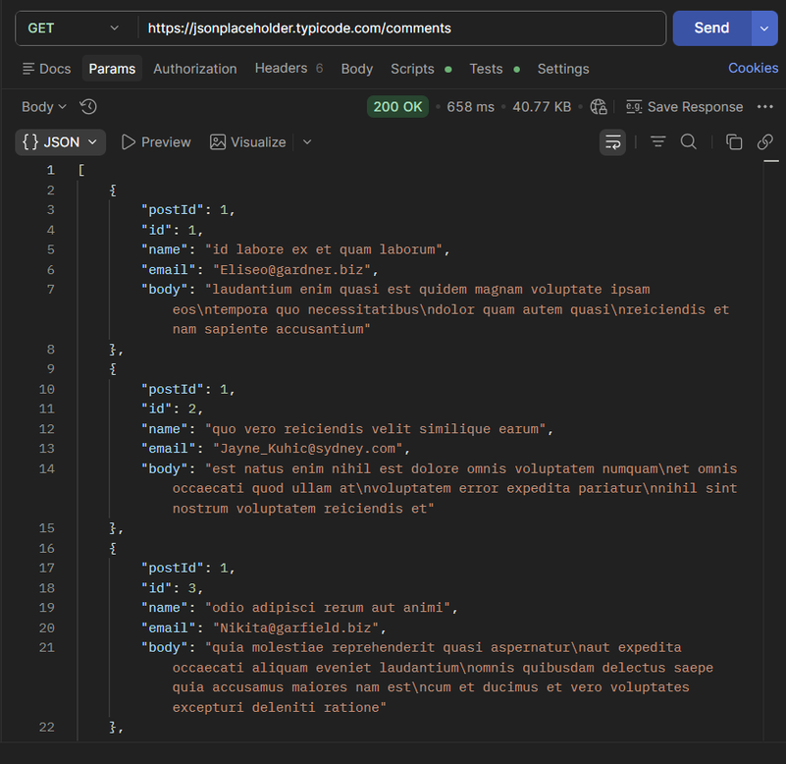

Slide 6
ENDPOINT ANALYSIS
/users
• User-related data publicly accessible
/posts
• Application data accessible without authentication
/comments
• Public exposure of comment-related data
Risk Classification:
MEDIUM

Slide 7
IDENTIFIED API SECURITY RISKS
• Missing authentication controls
• Excessive data exposure
• Public endpoint accessibility
• Lack of visible rate limiting
Potential Impact:
Unauthorized access, information disclosure, and abuse risks.
BUSINESS IMPACT
Insecure APIs may result in:
• Exposure of sensitive information
• Increased attack surface
• Unauthorized access risks
• Compliance and reputation concerns
API security is critical for modern SaaS and cloud applications.

Slide 8
REMEDIATION RECOMMENDATIONS
• Implement authentication mechanisms
• Apply authorization controls
• Reduce unnecessary data exposure
• Enable API rate limiting
• Monitor API traffic
• Validate user inputs securely
CONCLUSION
The API security assessment identified common API security concerns related to authentication, public accessibility, and excessive data exposure.
The project demonstrates the importance of secure API design and strong security controls in modern applications.
The assessment was conducted ethically using public test APIs and non-intrusive analysis methods.

Slide 9
THANK YOU
Future Interns — Cyber Security Internship
Prepared By:
Sidhanth Achar

